Slide 2
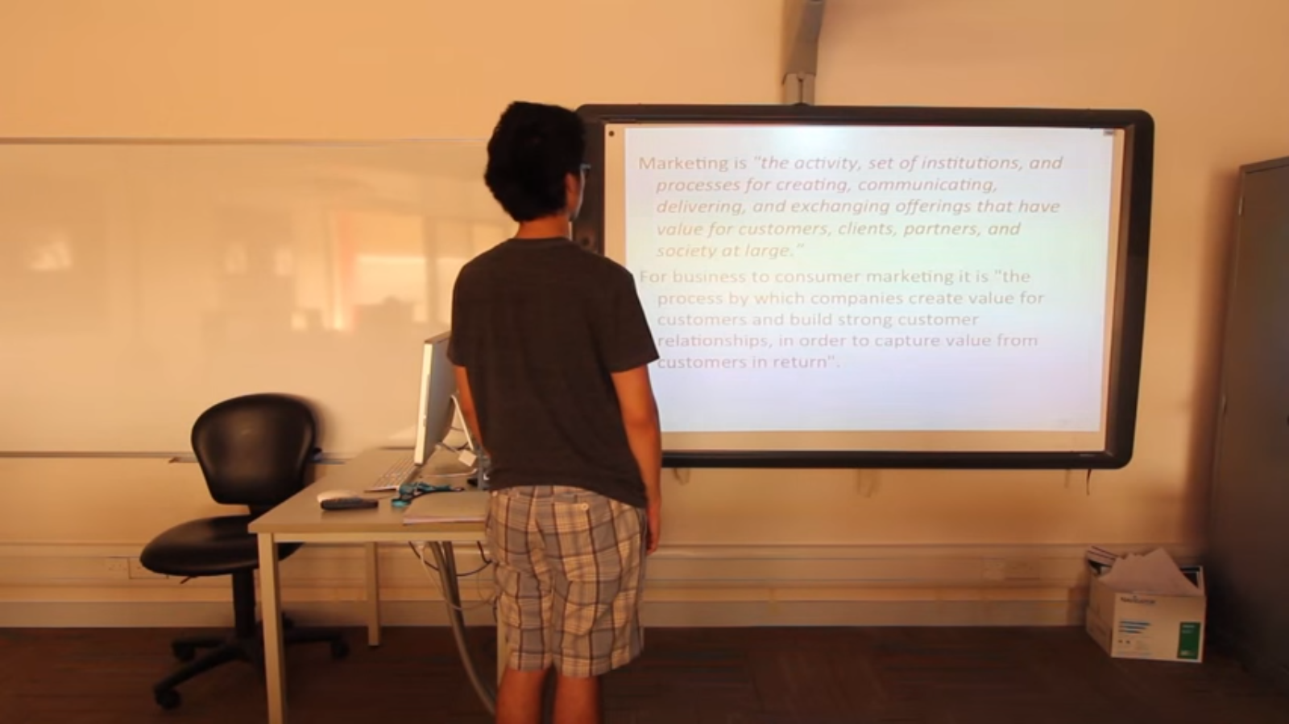
“Presenting to the screen”

Slide 3
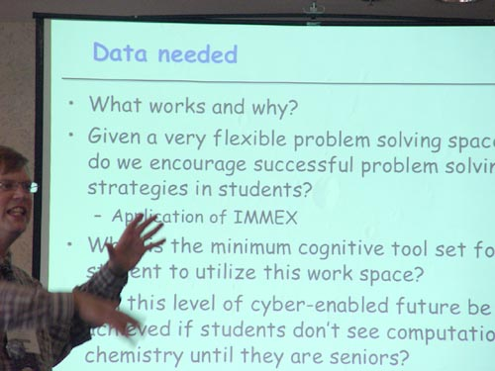
Too Much Text

Slide 4

Even More…

Slide 5
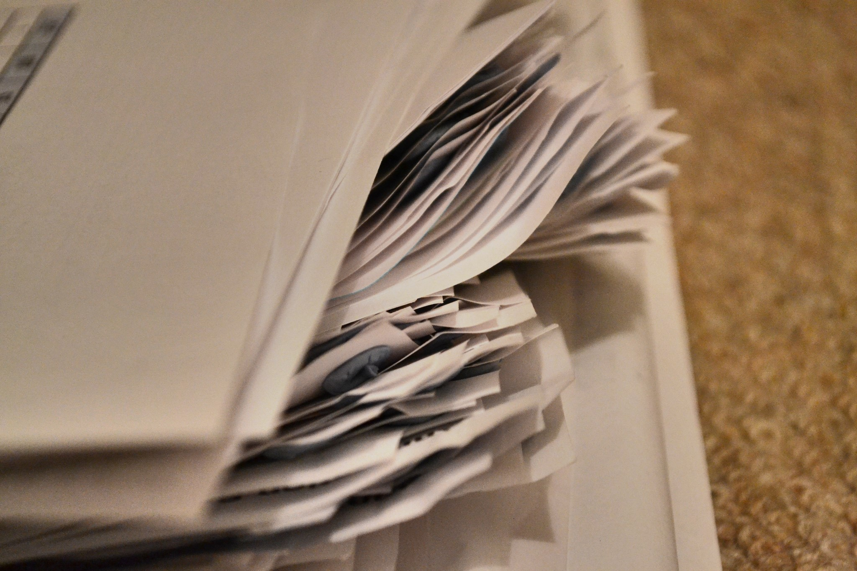
What most People Do ?
Prepare the script and write notes on paper
be near the computer while presenting or use phone for notes
Memorize the whole script

Slide 6

Our Solution?
Notes:
Is right here (show hand)

Slide 7
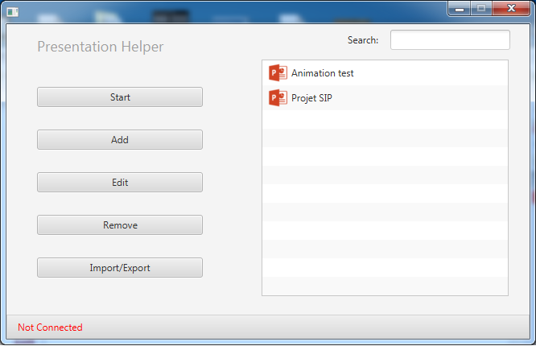

Presentation Helper
Notes:
What we call it presentationHelper

Slide 8

You can change slides.
Notes:
Change slides easily

Slide 9

Just by swiping.
Notes:
you don’t need to stay close

Slide 10

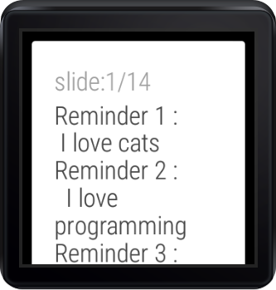
Notes , Slides Counts, Scrolling
Notes:
The way it looks…
Microphone

Slide 11
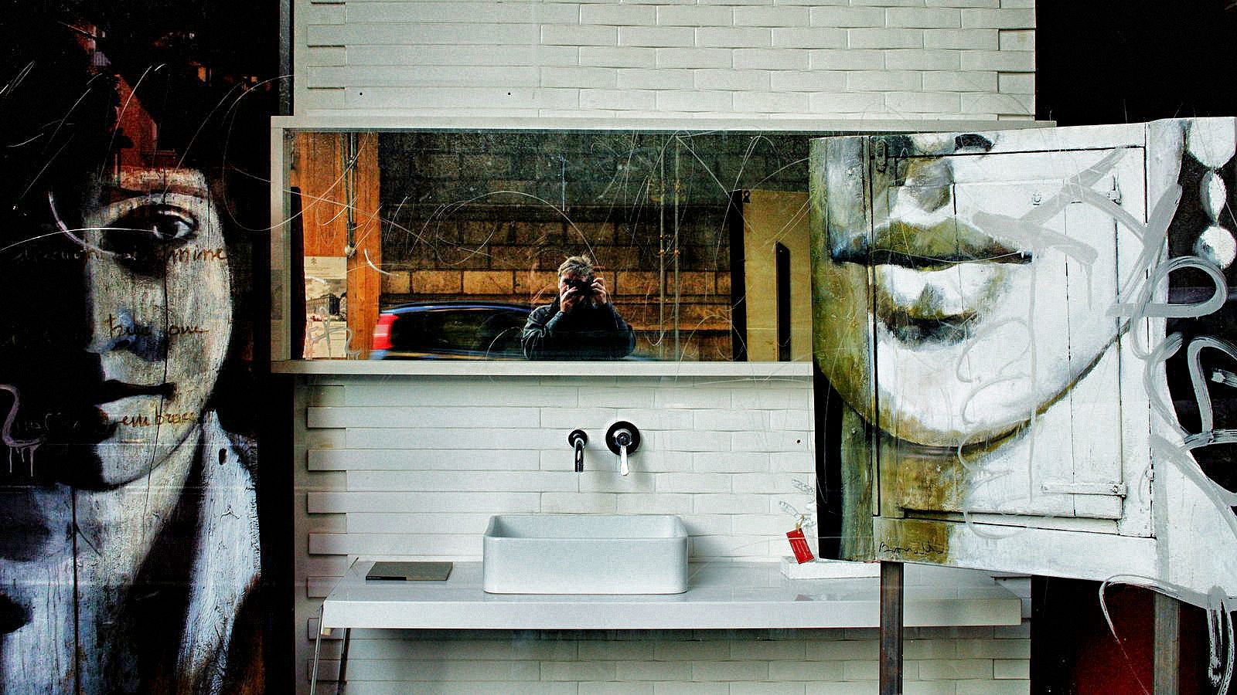
Free hands
Notes:
Fling

Slide 12

Move by gesture
Notes:
Fling with the watch

Slide 13
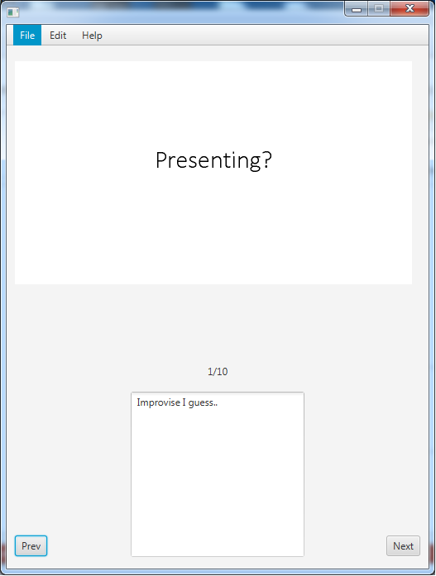
How it works?
App used on Desktop and Android Wear
Notes editor on Desktop platform
Notes sent to the watch
Connection via Bluetooth
Notes:
You talk here about the note editor

Slide 14
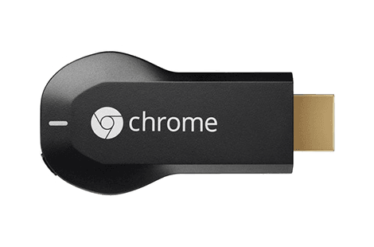
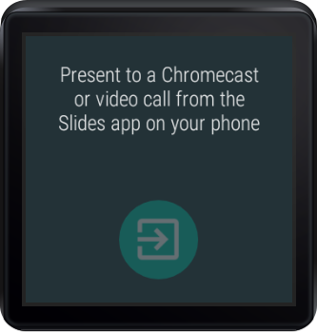
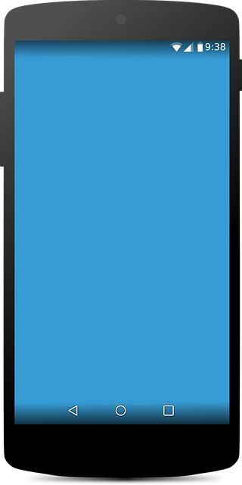
Unlike “Google Slides” app
+ +
Wifi Connection is required
Chromecast is required
Phone is required

Slide 15









Credits
Developers:
Emmanuel
Learning Android Wear, Android, Java and Git
e96e6e6@gmail.com
Jad
Learning Java, JavaFX and Git
jadchwork@hotmail.com
Special Tanks:
LesPitonneux, PercoLab, Montreal New Tech, Mentors
Notes:
Our Stories: Struggles

